Slide 1


Introduction to Prolin
LiuChuan
2017.4
百富计算机技术（深圳）有限公司

Slide 2
Contents
01
Introduction
02
OS architecture
Prolin
03
Functions and features
04
Communication

Slide 3
What is Prolin?
Prolin is a POS terminal operating system
Provides the following services:
Prolin OS
Prolin
Documentation
Development
Toolkits

Slide 4
Origin
PAX founded the US subsidiary company in 2008.
US market required a multi-tasking operating system.
Prolin is based on GNU/Linux operating system.

Slide 5

Why did we choose Linux?
Prolin-2.4 Kernel-3.0.56
Prolin-phoenix-2.5 Kernel-3.0.56
Prolin-cygnus-2.6 Kernel-3.6.5
Prolin-pelican-2.7 Kernel-4.1.15
Multi-tasking
Multi-user environment
Multi-peripheral devices
Deep hierarchy of folders
Dynamic libraries support
Lots of open source software

Slide 6
History
Prolin-2.0 - Prolin-2.3
Prolin-phoenix-2.5
Prolin-pelican-2.7
NGFP project
S300,S800,S900
Not support now
US retail market requirement
P^{x}5, P^{x}7
Chinese market requirement
SP200, Q20
2011 - 2012
2015 - Now
2017 - Now
2013 - Now
2016 - Now
Prolin-2.4
Prolin-cygnus-2.6
German CCV requirement
S300,S800,S900,D200,S920
New generation of products
Q80, Q80S, D220,
Q90, Q90S ,Q30,QR55

Slide 7
OS Version List
Standard version
CCV version
Inpas version
Customized TM
Boot for S800 and S900
Customized Boot for D200
Different OS signature
Customized PED (RKI)
Add libtrsys for PED
Brazil version
Customized PED
TM(APP copy directly)
TRSYS version
Customized PED(RKI)
Add libtrsys for PED
Privatbank version
Customized Keyman
Kernel(kernel support ext4 and swap)
Novelpay version
Customized PED
Add libnovelpay for PED
D200 config file (customized button screen printing)
Bendigo version
APCA PED,
Add libbendigo for PED
China version
Samport version
Chinese as default language (TM, Debug warning)
paxfont.ttf deleted, WQY font must be installed
Customized PED (four level key management)

Slide 8
OS Comparison
Prolin-2.4 vs. Prolin-phoenix-2.5 vs. Prolin-cygnus-2.6 vs. Prolin-pelican-2.7
双击添加标题文字
Hardware differences
Software compatibility
CPU
2.4 BCM5892 400MHz
2.5 BCM5893 400MHz
2.6 BCM5830x1GHz or 500MHz
2.7 Freescale IMX6UL 533MHz
Flash
2.4 128MB
2.5 256MB
2.6 256MB or 512MB
2.7 128MB or 256MB
SDRAM
2.4 64MB
2.5 256MB
2.6 256MB or 512MB
2.7 256MB
Versions of four OS are not compatible with each other
P^{x}X’s Boot is not compatible with which of Sxxx and D200
Qxx and D220’s Boot is not compatible with which of P^{x}X, Sxxx and D200
Versions of four OS can use the same SDK, SDK-2.8
APIs of four OS are compatible with each other

Slide 9
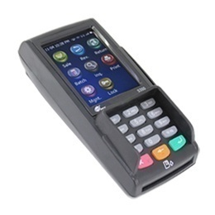
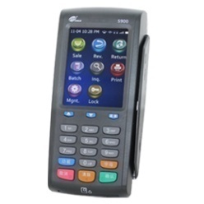
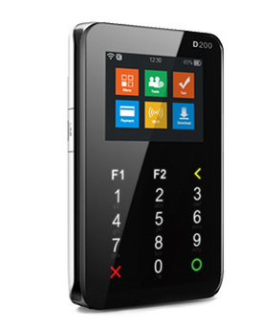
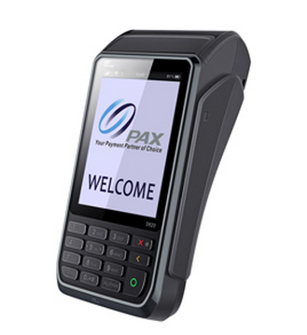
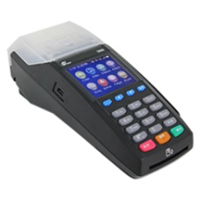
Module List-1
S300
CPU BCM5892 400MHz
LCD 240*320
S800
S900
CPU BCM5892 400MHz
D200
CPU BCM5892 400MHz
RF
ICC
MSR
CPU BCM5892 400MHz
LCD 320*240
RF
ICC
MSR
LCD 240*320
RF
ICC
MSR
LCD 320*240
RF
ICC
MSR
PCI4.1
PCI4.1
PCI4.1
PCI4.1
S920
CPU BCM5892 400MHz
LCD 240*320
RF
ICC
MSR
PCI4.0
GPRS
ETH
GPRS
BT
WiFi
GPRS
BT
Printer
Printer
Printer
GPRS
WiFi
BT
ETH
Prolin-2.4
Prolin-2.4
Prolin-2.4
Prolin-2.4
Prolin-2.4

Slide 10
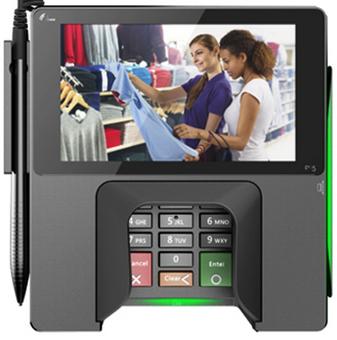
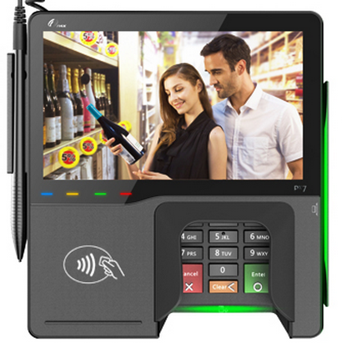
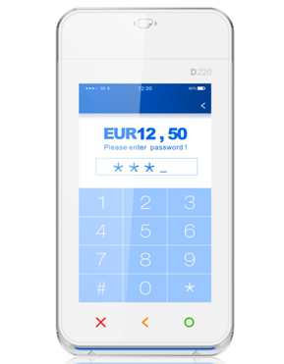
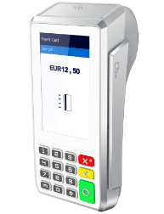
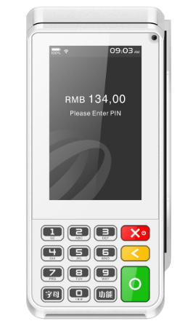
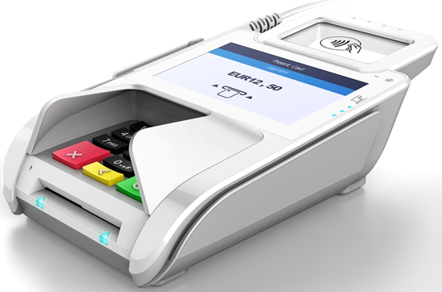
Module List-2
D220
Q80
CPU BCM58303 1GHz
CPU BCM58303 1GHz
P^{x}5
LCD 480*800
RF
ICC
MSR
PCI4.0
LCD 480*800
RF
ICC
MSR
PCI4.0
P^{x}7
GPRS
WiFi
BT
GPRS
WiFi
BT
Prolin-phoenix-2.5
Prolin-phoenix-2.5
Prolin-cygnus-2.6
Prolin-cygnus-2.6
CPU BCM5893 400MHz
LCD 800*480
RF
ICC
MSR
GPRS
WiFi
BT
ETH
PCI4.0
CPU BCM5893 400MHz
LCD 800*480
RF
ICC
MSR
GPRS
WiFi
BT
PCI4.0
ETH
ETH
Modem
No physical numeric keys
Q90
Q30
Prolin-cygnus-2.6
CPU BCM58303 1GHz
LCD 480*800
RF
ICC
MSR
GPRS
WiFi
BT
ETH
PCI5.0
Prolin-cygnus-2.6
CPU BCM58303 1GHz
LCD 800*480
RF
ICC
MSR
GPRS
WiFi
BT
ETH
PCI5.0
Camera
Camera
Camera
Camera

Slide 11
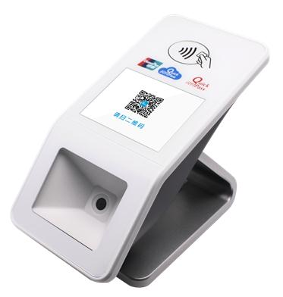
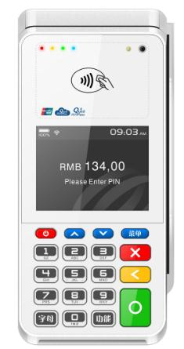

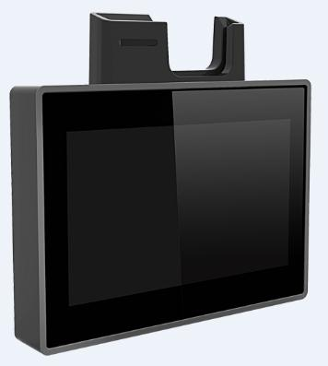
Module List-3
QR55
CPU BCM58302 500MHz
LCD 320*240
Q80s
Q90s
CPU BCM58302 500MHz
SP200
CPU IMX6UL 528MHz
RF
CPU BCM58302 500MHz
LCD 320*240
RF
ICC
MSR
LCD 320*240
RF
ICC
MSR
LCD 320*240
RF
PCI5.0
PCI5.0
PCI5.0
Q20
CPU IMUX6UL 528MHz
LCD 480*272
RF
ICC
MSR
PCI5.0
GPRS
ETH
GPRS
WiFi
BT
Printer
Printer
WiFi
BT
Prolin-cygnus-2.6
Prolin-cygnus-2.6
Prolin-cygnus-2.6
Prolin-pelican-2.7
Prolin-pelican-2.7
WiFi
BT
WiFi
BT
WiFi
BT
Camera
Camera
Camera
Camera
No physical numeric keys
No physical numeric keys

Slide 12
OS Architecture
Main application
Sub application
TM
Linux kernel + drivers
POSIX interface
OSAL
System Libraries
BusyBox
System Daemons
XUI
Hardware

Slide 13
Prolin-2.4 Flash Partition
Partition | Type | Size | Mount point | Image
Kernel | RAW | 4 MB |  | kernel-2.4.img
Rootfs | RAW (flash) tmpfs (runtime) | 6 MB | / | ramdisk-2.4.img
Basefs | RAW (flash) tmpfs (runtime) | 6 MB | /base | base-2.4.img
Data | UBI fs | 110 MB | /data
Removable | Customized |  | /mnt/usb_storage
* The data partition can use up to 110MB
* Data partition is used to store applications, application libraries, resources, application data, etc.
* Removable media (USB/Flash disk/TF Card) is used to save application logs, update images, application backups, etc.

Slide 14
Prolin-phoenix-2.5 Flash Partition
Partition | Type | Size | Mount point | Image
Kernel | RAW | 6 MB |  | kernel-2.5.img
Rootfs | RAW (flash) tmpfs (runtime) | 12 MB | / | ramdisk-2.5.img
Basefs | RAW (flash) tmpfs (runtime) | 12 MB | /base | base-2.5.img
Data | UBI fs | 224 MB | /data
Removable | Customized |  | /mnt/usb_storage
* The data partition can use up to 224MB
* Data partition is used to store applications, application libraries, resources, application data, etc.
* Removable media (USB/Flash disk/TF Card) is used to save application logs, update images, application backups, etc.

Slide 15
Prolin-cygnus-2.6 Flash Partition
Partition | Type | Size | Mount point | Image
Kernel | RAW | 12 MB |  | kernel-2.6.img
Rootfs | RAW (flash) tmpfs (runtime) | 24 MB | / | ramdisk-2.6.img
Basefs | RAW (flash) tmpfs (runtime) | 24 MB | /base | base-2.6.img
Data | UBI fs | 448/192 MB | /data
Removable | Customized |  | /mnt/usb_storage
* The data partition can use up to 448/192MB
* Data partition is used to store applications, application libraries, resources, application data, etc.
* Removable media (USB/Flash disk/TF Card) is used to save application logs, update images, application backups, etc.

Slide 16
Prolin-pelican-2.7 Flash Partition
Partition | Type | Size | Mount point | Image
Kernel | RAW | 12 MB |  | kernel-2.7.img
Rootfs | RAW (flash) tmpfs (runtime) | 12 MB | / | ramdisk-2.7.img
Basefs | RAW (flash) tmpfs (runtime) | 12 MB | /base | base-2.7.img
Data | UBI fs | 200/80 MB | /data
Removable | Customized |  | /mnt/usb_storage
* The data partition can use up to 200/80 MB
* Data partition is used to store applications, application libraries, resources, application data, etc.
* Removable media (USB/Flash disk/TF Card) is used to save application logs, update images, application backups, etc.

Slide 17
OS Startup Flow
ROM
Boot
(Running in CPU internally)
Prolin
Boot
Prolin Kernel
(Linux kernel)
Terminal Manager
/
Main Application
System Daemons
Init
Process

Slide 18

System Applications
Point of sale PIN Entry Device
Network management service
Terminal Manager
PED
Ipservice
TM
Modem management service
Switch TM and main application
Modemd
Keyman
System debug service
Get system and application log
XCB
Logcat
Power management service
System service
Install system and application package
Installer
System application list

Slide 19
Keyman (switcher)
Main application
Terminal Manager
Switcher
Switcher

Slide 20
Package List
For more detailed description, please refer to <Prolin 2.X User Guide> and <Prolin Application Development Manual>.
AIP (Application Installation Package)
AUP (Application Upgrade Package)
OPT (System optional component package)
FWP (Module firmware upgrade package)
Zip format, e.g., mainapp.aup
The only difference with AIP is that the bin file which is assigned in appinfo does not need to be included in AUP package
.tar.gz format, e.g., libbt.tar.gz
Examples: Bluetooth library, Font, Player, cURL library, QR code library, and so on
Using a new module firmware upgrading mechanism
Zip format, e.g., mainapp.aip
Application programs may find linked libraries in ./lib folder at runtime
Signature machine will sign all the binary files in ./bin folder
Support upgrading all the application files
The package includes three files, which are upgrade, module firmware, and fwpinfo
Examples: Barcode module, Wireless module, Touch screen module, Cipher chip, and so on
AIP package, bin file which is assigned in appinfo, and bin file in ./bin folder will be signed
Stored in /data/opt folder

Slide 21
System Upgrade
For more detailed description, please refer to <Prolin 2.X User Guide> and <Prolin Application Development Manual>.
U-Disk
Install / Upgrade AIP, AUP, OPT, FWP, US_PUK, logo, and OS
Support muti-system.list downloading
Protims
Install / update AIP, AUP, OPT, FWP, US_PUK, and OS
Through GRPS, WCDMA, FDD_LTE, Ethernet, WiFi, Modem
TermAssist
Install / update AIP, AUP, OPT, FWP, US_PUK, logo, Boot, and OS
Through Serial, USB, Ethernet
Main application
Install / update AIP, AUP, OPT, FWP, US_PUK, logo, Boot, and OS

Slide 22




Application Programming Interface
For more detailed description, please refer to <Prolin API Programming Guide>.
POSIX
OSAL
File system
Threads
BSD sockets
Device drivers
IC Card Reader
RF Card Reader
Magnetic Card Reader
Printer
Internal PED
Modem
Networking configuration
System
Power management
Input subsystem and Framebuffer
XUI QT-4.8
Touch Screen
Keypad
LCD
Prolin graphical user interface

Slide 23
Security Control
Signature & Verification
Config file & Debug level
ROM boot verifies boot
Boot verifes kernel, rootfs
Kernel verifies drivers
Kernel verifies basefs
Kernel verifies applications and libraries
RSA-2048 + SHA-256
Configuration file must be signed, otherwise it cannot be loaded
Debug level is written in configuration file
Debug level = 0, system release version, all firmware and executable files must be signed and verified
Debug level = 1, system debug version, for application development, applications need not be signed and kernel will not verify executable files
Application privileges
Using Linux kernel capabilities control
Main application has more capabilities: CAP_NET_ADMIN & CAP_NET_RAW & CAP_SYS_BOOT & CAP_SYS_TIME & CAP_KILL

Slide 24
More Security Control
 | Debug level = 0 | Debug level = 1
Boot loader verifies kernel & config file signature | Yes | Yes
Kernel verifies system applications and libraries signature | Yes | Yes
Kernel verifies user applications signature | Yes | No
BusyBox | No | Yes
/proc | No | Yes
Shell | No | Yes
Console | No | Yes Permission: MAINAPP

Slide 25
Development Support
Eclipse based
Support emulation
GDB Server
Start gdb server in terminal
Use RS232 or Ethernet to debug
Crash Report
Crash report is an additional service help to collect application crash information (stack information).
Application registers to crash report service
Log Service
http://developer.android.com/tools/debugging/debugging-log.html
Use OsSetLogTag() and OsLog() to replace printf()
Use logcat command to show log or call the logcat program in application
If application exits abnormally, use crash report to get details
Full GNU toolchain GCC 4.6.3 version
Package tools

Slide 26

Key Management
Asymmetric Key
KEY
Symmetric Key
RSA key
3DES Key
X_PUK
X_PVK
MK/SK
DUKPT
MF_PUK
MF_PVK
TLK
TLK
MK_PUK
MK_PVK
TMK
TIK
US_PUK
US_PVK
TAK/TDK/TPK
KSN
Verification
Stored in raw flash
Signature
Stored in signature machine
Mach fixed key
Stored in /data file system
PIN/MAC key
Stored in /data file system

Slide 27
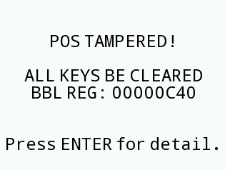
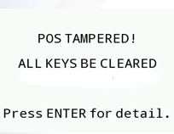
Tamper Detection
Tamper
Hardware tamper
Software tamper
1. Voltage
2. Temperature
3. Frequency
4. Four dynamic Sensors
1. Boot erased data partition
2. PED key check error
Delete SEK

Slide 28
Registry Table
Registry table
双击添加标题文字
ro.fac.xxx (read only)
persist.sys.xxx (read and write)
Describes all the hardware module configuration, e.g., ro.fac.radio=05
Stored in raw flash instead of file system
Come from configuration file or xxx.init.rc
Both main application and sub application can read it though OsRegGetValue() function
Application cannot modify or delete it
Describes some software configuration,e.g., persist.sys.sleeptime=0
Stored in /data/property file folder
Come from system application or main application
Both main application and sub application can read it though OsRegGetValue() function
Only main application can modify it through OsRegSetValue() function, sub application doesn’t have the permission

Slide 29
3rd Party Libraries
OpenSSL
FreeType
OpenSSL is an open source project that provides robust, commercial-grade, and full-featured toolkit for Transport Layer Security (TLS) and Sockets Layer (SSL) protocols.
FreeType is a popular software development library, used to render text on to bitmaps and provides support for other font-related operations.
libz, xz, libarchive
png, jpeg
Zlib is a software library used for gzip file compression.
XZ Utils is free general-purpose data compression software with a high compression rate.
libarchive is a multi-format archive and compression library.
libpng is the official Portable Network Graphics (PNG) reference library (originally called pnglib).
libjpeg is a free library with functions for handling the JPEG image data format.

Slide 30
Capabilities
Introduction
For the purpose of performing permission checks, starting with version 2.2, Linux divides the privileges traditionally associated with superuser into distinct units.
MAINAPP | SUBAPP
CAP_NET_RAW Allow use of RAW sockets Allow binding socket to interface | CAP_NET_RAW Allow use of RAW sockets Allow binding socket to interface
CAP_NET_ADMIN Allow modification of routing tables Allow multicasting
CAP_SYS_BOOT Allow use of reboot
CAP_SYS_TIME Allow setting the real-time clock and system clock
CAP_KILL Allow sending signal to other process which in same group

Slide 31
Data Partition File Structure - system
Directory | Instruction
/data/etc | System configuration file which is compatible with the standard Linux
/data/property | System parameter catalogue (persist.sys.xxx)
/data/security | The key of PED catalogue
/data/var | The directory of system variables list which is compatible with the standard Linux
/data/var/opt/ | File list of all the installed optional packages which is read by MAINAPP to check optional packages information

Slide 32
Data Partition File Structure - application
Directory | Permission of MAINAPP | Permission of SUBAPP | Purpose
/data/tmp | [RW] | [RW] | Store temporary files (persistent across system reboot)
/data/public | [RW] | [RW] | Store files shared by multiple applications
/data/app/XXX | [--] | [--] | Store files read and written by the current application
/data/appinfo | [RW] | [--] | Store all downloaded applications information, which is read by MAINAPP
/data/tombstones | [R-] | [--] | Saved crash reports
/opt | [RW] | [R-] | Store extension library and font directory
/opt/fonts | [RW] | [R-] | Font directory of installed font package

Slide 33
Documentation
API introduction
API Programming Guide
Operating Guide& User Manual
Prolin Application Development Manual
Prolin IPv6 Programming Guide
Prolin 2.X User Guide
Prolin SDK Operating Guide
Prolin API Programming Guide
Prolin PPP direct Interface
Prolin XUI Interface
Prolin Bluetooth Programming Guide
Prolin Bluetooth Interface
Prolin US_PUK Instruction
Prolin SLIP Interface
Prolin WiFi Programming Guide
Prolin Barcode Library Programming Guide
Prolin System Low Power Programming Guide
D220 Programming Guide
PxX Programming Guide
Prolin Player Programming Guide
QR55 Programming Guide

Slide 34
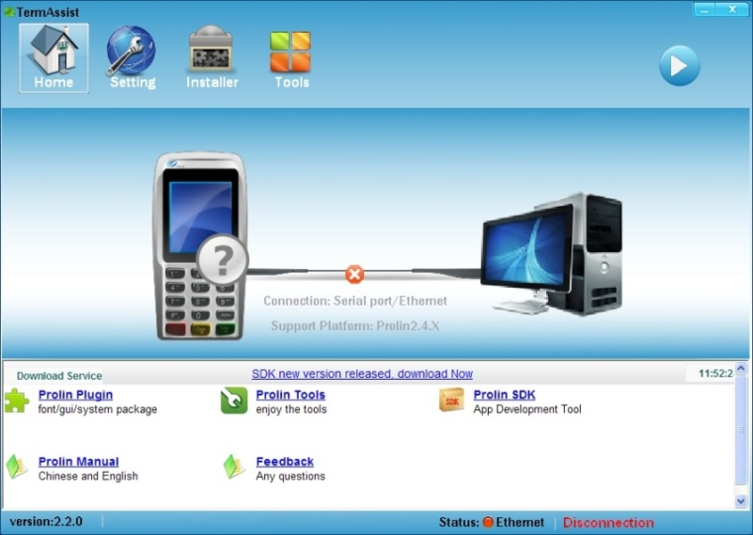
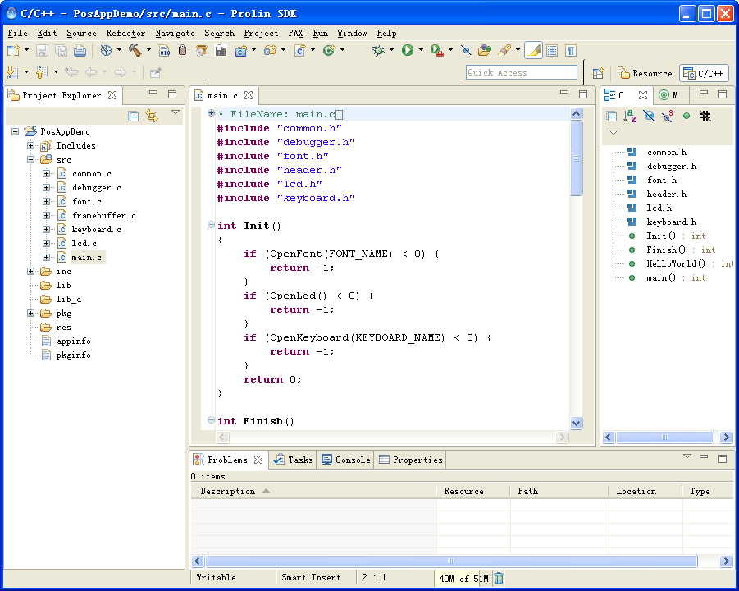
TermAssist-3.0
Development Toolkits
SDK-2.8

Slide 35
Main Features Upgrade
Features | Prolin-2.4 | Prolin-phoenix-2.5 | Prolin-cygnus-2.6 | Prolin-pelican-2.7
Authorization mechanism | Yes | Yes | Yes | Yes
Remote key injection | Yes | Yes | Yes | Yes
Support Platform-phoenix | No | Yes | Yes | No
New US_PUK management | Yes | Yes | Yes | Yes
XUI support video play | No | Yes | Yes | No
Module firmware upgrade | Yes | Yes | Yes | Yes
Low power mechanism | Yes | Yes | Yes | Yes
Linux firewall (iptables) | Yes | Yes | Yes | Yes
Gesture Recognizer | No | No | Yes | No
Encrypt and mount SD card | Yes | Yes | Yes | Yes
IPv6 | Yes | Yes | Yes | Yes
Base (S920, P^{x}7) | Yes | Yes | No | No
GPS | Yes | Yes | Yes | No

Slide 36
Authorization mechanism
In order to solve below problems
SN might be modified randomly
Manufacture Default State (L1) / Security State (L2)
Unlock tamper by pressing password under L1 status
Tamper can be unlocked by pressing password simply
Unlock tamper via authorization tool under L2 status
How to switch to authorization mechanism?
Switch to authorization mechanism through Boot, Boot-2.x version is non-authorization mechanism, Boot-3.x and above is authorization mechanism
Boot can be upgraded but not degraded, it means non-authorization mechanism can be switched to authorization mechanism, but authorization mechanism cannot be switched to non-authorization mechanism
Application might be changed without permission
Prolin-2.4 and Prolin-phoenix-2.5 support both mechanisms, Prolin-cygnus-2.6 and Prolin-pelican-2.7 only support authorization mechanism
Set App Debug Authority / Set Firmware Debug Authority
“Set App Debug Authority ” is equal to “Debug_level=1”, it means it is unnecessary to sign application
“Set Firmware Debug Authority” is equal to “Debug_level=2”, it means OS and application are not necessary to be signed
No need to replace the configuration file to set debug mode
Application might be developed when terminal is not authorized
For more detailed description, please refer to <Authorization Tool Operating Guide>
Both OS and application must be signed under L1 or L2 status

Slide 37
Remote Key Injection
Introduction
In order to inject the main key securely in merchant environment, the RKI system includes three stages.
Supported in Prolin-2.4, Prolin-phoenix-2.5, Prolin-cygnus-2.6 and Prolin-pelican-2.7.
For more detailed description, please refer to <Prolin RKI Interface>.
Production phase / Maintenance stage
Bind stage
Key inject stage
RKI server sends RKIAK_PUK_SIG to POS
POS mutually authenticates with RKI server through the current certificates
RKI server encrypts the IK/IKSN by using the DE_PUK_SIG and sends it to POS
The device key pairs (DA_PUK_SIG/DA_PVK and DE_PUK_SIG/DE_PVK) are generated by the local hardware encryptor
POS saves RKIAK_PUK_SIG
POS mutually authenticates with RKI server through the current certificates
POS sends DA_PUK_SIG and DE_PUK_SIG to RKI server
POS sends DA_PUK_SIG to RKI server
The public keys are sent to the CFCA and signed by CFCA
The device certificates and the related private keys are injected into the device
POS decrypts the IK/IKSN by using the DE_PVK and saves the IK/IKSN

Slide 38

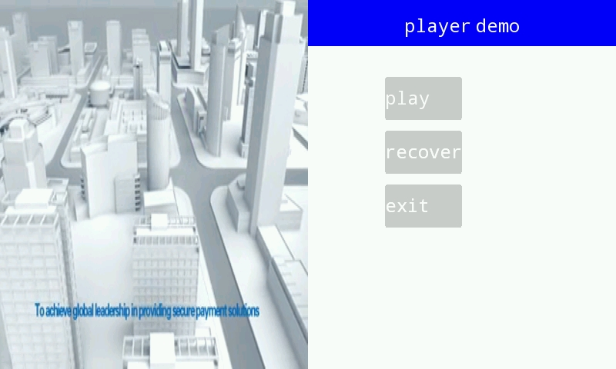
Player
For more detailed description, please refer to <Prolin Player Programming Guide>.
Player-phoenix
Only supported in Prolin-phoenix-2.5
Limited by CPU hardware decoding module, video must be converted through PAX Video Converter to .avi format
Player-cygnus
Only supported in Prolin-cygnus-2.6
Usage
The terminal must install the Player-phoenix or Play-cygnus OPT package first
Based on Linux standard GStreamer framework
Using /opt/bin/player command and parameters to play
Player command and parameters for Player-phoenix is the same with Player-cygnus
Supported several formats, such as .mkv, .mp4, .avi, .wmv, .3gp, .mpg, .flv, .mov, .vob, and .rmvb
Based on Linux standard Mplayer framework
Supported split-screen play, as is showed by the right picture

Slide 39
Platform-phoenix
Introduction
For the new line of Multi-Lane terminals that are being developed for the US retail market place. It is a MAINAPP.
Only supported in Prolin-phoenix-2.5 and Prolin-cygnus-2.6 .
Main features
Browser Analyze the specific file which designed by POS Designer UI is separated from logic
Permission management Run unsigned applications whose permissions are lower than signature application
Desktop Manage and run applications and platform configuration
Video playback Support play H.264 video format, maximum video size is 640x480
Multi-mode signature Support three modes: Only pen, Only finger, Both pen and finger
SRED Support three-mode p2p, such as voltage, dukpt, transarmor
EMV Support contact EMV and contactless PAYPASS and PAYWAVE

Slide 40
US_PUK Management Upgrade
US_PUK0
US_PUK1
US_PUK7
US_PUK8
……
Support up to nine US_PUKs
When installing the application, the application will be verified by all US_PUKs automatically
Each US_PUK can be deleted directly
Applicable to Prolin-2.4.38 and below
CS_PUK0
Signed by MK_PVK
CS_PUK1
Signed by CS_PVK0
CS_PUK2
Signed by CS_PVK1
Cannot be deleted
Can be deleted
Can be deleted
Support up to three US_PUKs
The application only can be verified by the last installed US_PUK
US_PUK can be deleted by higher level US_PUK
For example, when installing US_PUK1 signed by US_PUK2, the US_PUK2 will be deleted
Applicable to Prolin-2.4.39 and above, Prolin-phoenix-2.5, Prolin-cygnus-2.6, Prolin-pelican-2.7
For more detailed description, please refer to <Prolin US_PUK Instruction>

Slide 41
Low Power Mechanism
For more detailed description, please refer to <Prolin System Low Power Programming Guide>.
Optimize battery check
Optimize the algorithm of battery check. Systemservice will collect sample every 2 seconds, for 30 times continuously, then get the average value
Terminal wake-up at specified time
Terminal will wake up at specified time set by OsSysSleepTime().
Systemservice collects sample and compensates voltage when RF module is on, while not collect in the process of printing because the printer and RF module consume too much battery
Due to the limit of CPU, the wake-up time of Prolin-2.4 will float within ±128s, while it only floats ±1s for Prolin-cygnus-2.5 and Prolin-pelican-2.7
Battery check
OsSysCheckBattery() can read five electricity levels, printer, RF module, Wireless module cannot work under level-0.
More accurate battery information (from 0%-100%) can be read via /sys/class/power_supply/battery/capacity for S920, D220, Q90
Event notice and Setting
Application can get events info: Terminal sleep, Terminal wake-up, Terminal screensaver, Screen wake-up, Terminal to be powered off
Setting: forbid device from sleeping, allow device to sleep, forbid device from entering screensaver mode, allow device to enter screensaver mode, forbid device from powering off and allow device to power off

Slide 42
Differences of D220
Introduction
D220 is PAX’s first touch screen POS terminal with no physical keypad.
For more detailed description, please refer to <D220 Programming Guide>.
Main difference
Download OS, Boot, logo, and Configuration file For traditional POS terminal, press the download key while starting the POS terminal will make POS enter the download mode. For D220, it doesn’t have a download key but a power key, when starting the terminal, D220 will enter the download mode automatically. So TermAssist has to enter the download mode first.
OS enters sleep mode automatically The sleep function of D220 is started by default, even when the terminal is powered by adaptor, the terminal will also enter the sleep mode when the waiting time is up.
Enter TM when MAINAPP exits at runtime For D220, it can’t use the traditional method which is keeping pressing the digit number 2 key to enter the TM like other POS terminals, but the user can keep pressing the Clear key on the bottom panel to enter TM.
System Crash and Hardware Shutdown When D220 operating system crashes and can’t respond to the software shutdown, pressing the power key for 6 seconds will force a hardware shutdown.
Keypad input Virtual keypad design has been added to the TM and PED of D220. XUI also added XuiShowSoftKeyboard() to support it.

Slide 43
More Friendly Design
Get debug message through TermAssist
Applicable toTermAssist-3.0 and above
Get debug messages through U-Disk
Applicable to Prolin-2.4.57 and above, Prolin-phoenix-2.5.5 and above, Prolin-cygnus-2.6, Prolin-pelican-2.7
Support in both debug version and release version OS
Debug messages obtained through TermAssist are the same as obtained by logcat command
Support in both debug version and release version OS
Debug messages obtained through TermAssist are the same as obtained by logcat command
Exporting through TM->System Report->Diagnosis menu
Add Cppcheck in SDK
Applicable to SDK-2.8.8 and above
Cppcheck is a static code analysis tool for C and C++ programming languages. It is a versatile tool that can check. non-standard code, such as memory leak and handle leak
For more detailed description, please refer to <Prolin SDK Operating Guide>
For more detailed description, please refer to <Prolin 2.X User Guide>
For more detailed description, please refer to <Prolin 2.X User Guide>

Slide 44
New Features Upgrade
HTML5
Camera + Soft Decoder
USB HID support
High-end version of S920 with support for Platform-phoenix
API of Soft Decoder is the same with the barcode module
Using OsPortOpen() and OsPortRead() function to read from external USB HID device
High-end version of S920 includes 128MB SDRAM and 256MB flash
The browser is a MAINAPP based on Qt-4.8
Support both one-dimensional codes and two-dimensional codes
Examples: USB scanning gun
Qt
Using Qt-4.8 version with OPT package
USB CDC support
Support the connection to USB CDC type device
OS switched to CDC type through TM, and takes effect after the terminal is rebooted
Encoding library for various barcodes
An encoding library for barcode, it supports QRCODE, PDF417, GRIDMATRIX, CODE128, CODE39, EAN13, EAN128, and AZTEC types
To match Platform-phoenix, high-end version of S920 supports Prolin-phoenix-2.5 as well as prolin-2.4

Slide 45
Future Features
Wayland
Soft AP
In Prolin-cygnus-2.6
In Prolin-cygnus-2.6
DHM
Prolin Base
In Prolin-2.4,
Prolin-phoenix-2.5,
Prolin-cygnus-2.6,
Prolin-pelican-2.7
In Prolin-2.4,
Prolin-phoenix-2.5,
Prolin-cygnus-2.6

Slide 46

THANKS !

